Slide 1
Our Group Project
“Shocking”
By Iarlaith, Yomna, Eoin and Joseph.

Slide 2
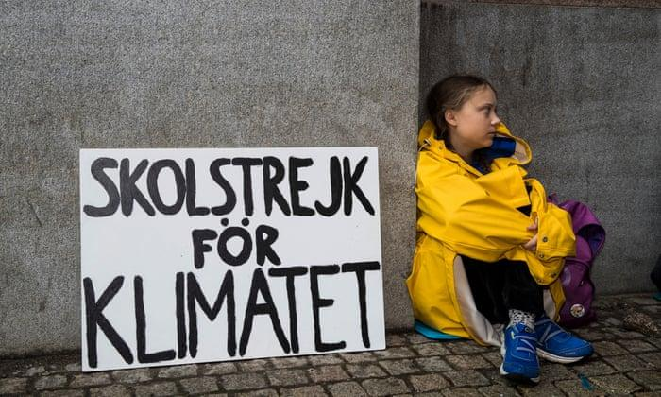
The Problem : Sustainability
The Climate crisis was recently brought in front of the world by Greta Thunberg and her “School strike for climate”
The support behind her showed how school and college students especially wish to fight against climate change and for environmental sustainability.

Slide 3
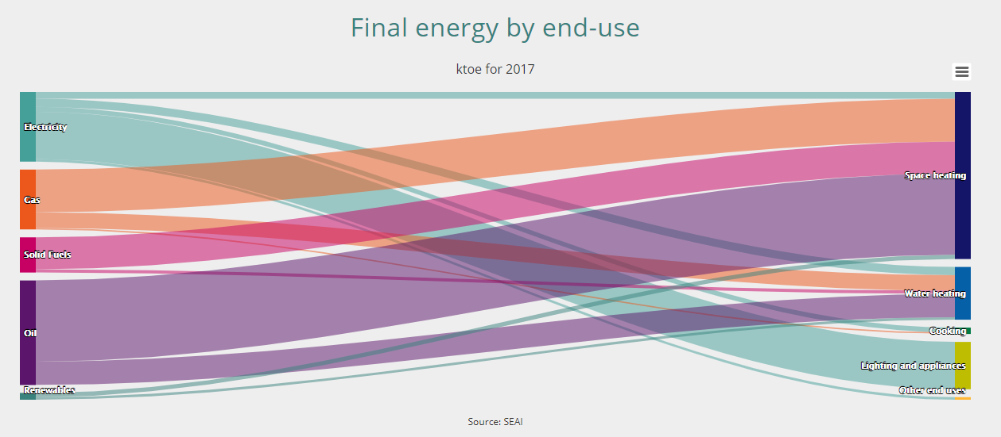
The Problem : Energy Consumption
In 2017, of the energy used in Irish households,
36.25% was by water heating, lighting and appliances.
In the EU, 29.2% of residential energy was used for water heating, lighting and appliances.

Slide 4
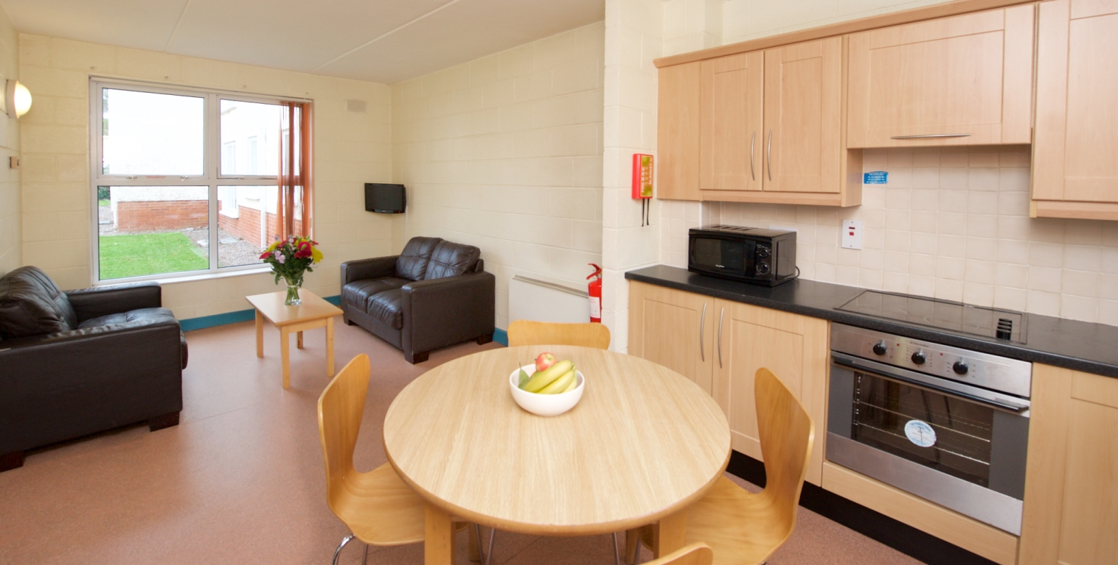
Researching the problem
We chose a conduct an ethnographic study of 6 college students in their home setting
The common room was monitored, along with the shower panel, for the period of a normal college week and weekend.

Slide 5
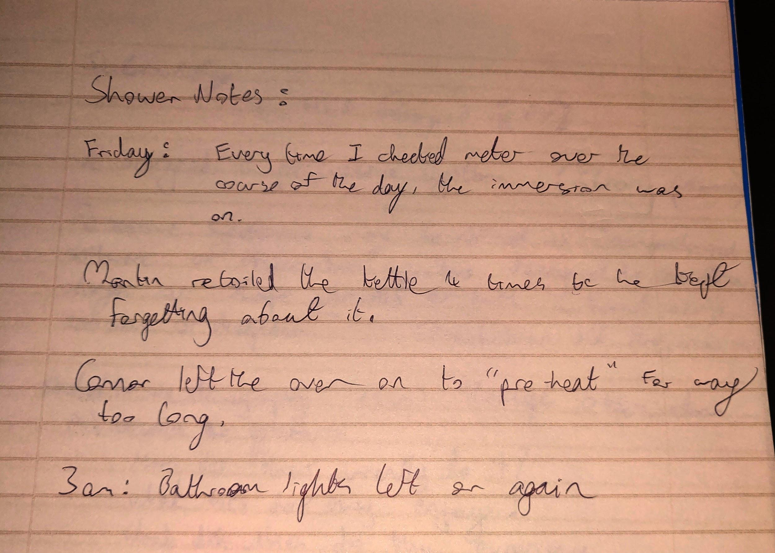
Researching the problem
The results:
The most used appliances were the kettle and microwave oven
Lights were often left on when no one was in the room
Immersion heater for the shower often left on for 1+ hours
They all agreed that an engaging personal energy consumption application would be very helpful

Slide 6
“That would be for me very helpful” - Oscar Zhang (2020)

Slide 7
Eoin bit

Slide 8
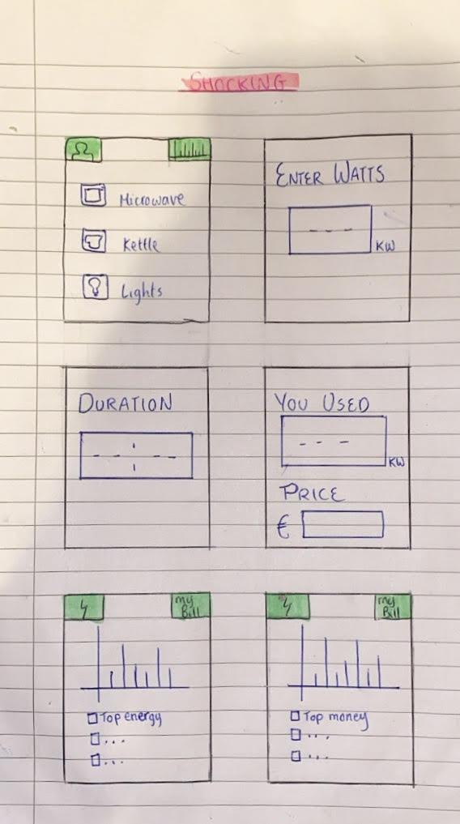
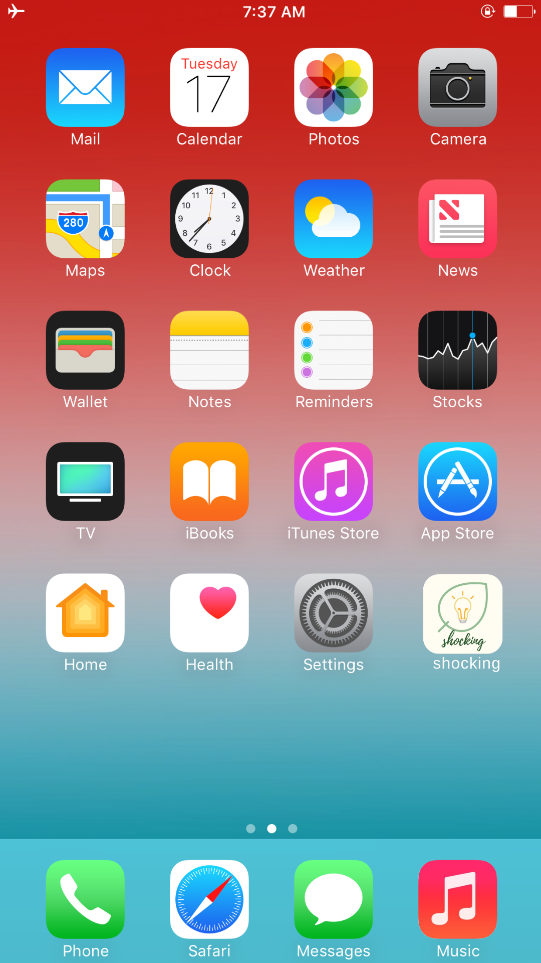
Prototype Evolution

Slide 9
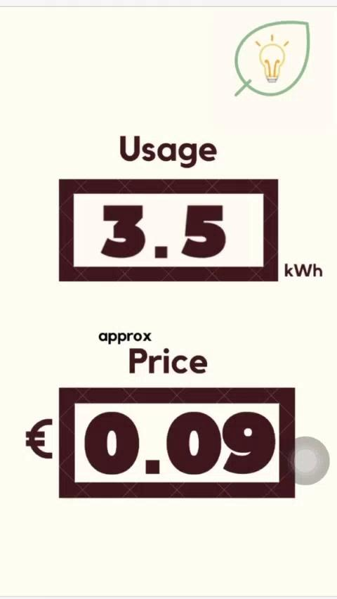
How the prototype is used
The user enters the appliance, its watts and the duration of use.
The app calculates how many watts were used altogether and how much it cost.
The app provides alternative ways this energy could be used.
There is a profile option for the user to set default settings.
All data inputted is recorded.

Slide 10
Are the users needs met?
The prototype is:
Simple
Quick
Allows for input
Original
Accommodates for all users

Slide 11
What’s good about this product?
Simplicity of use
The product is self explanatory, the user doesn’t have to be a tech genius to use the app.
Increases User’s awareness of Energy usage
People tend to be more efficient in usage if they know how much they are using.
Financial Savings for Users
If people cooperate with the goals of this app and subsequently reduce energy usage, their electricity bill will be lower.

Slide 12
What’s good about this product?
4. Reduced Carbon Footprint
By generating less energy, each household will emit fewer greenhouse gases. This results in an improved environmental performance from each house!

Slide 13
Problems with the product
High dependence on the user
Without the user’s input, this app would not be functional or beneficial.
Not all appliances are compatible with the app
The app requires appliances that are used for certain period of time whereas some appliances are turned on and off within the space of five seconds eg. microwave
Inconvenience for user
The user might find it lethargic to have to press ‘Start’ and ‘Stop’ every time she/he uses an electrical appliance.

Slide 14
Problems with the product
Only tracks personal usage
The app doesn’t account for other members of the house’s energy usage.

Slide 15
How to improve the product.
Connect the App to Electrical Appliances
Allows app to automatically monitor energy usage.
Removes the high level of dependency from the user.
→ Takes away the lethargic process of pressing stop and start every time you use an appliance.
All statistics will automatically be calculated, without any user input.
Makes all appliances compatible with the app.

Slide 16
How to improve the product.
Sync apps with other members of house
All members of house can be connected under the one house name.
More accurate overall costs and energy usage results.
Each member could compare their own energy usage to other people’s energy usage.

Slide 17

‘SHOCKING’
Thanks for listening!

